Slide 1

Persistence
An Introduction to the CRUD Process
Produced
by:
Dr. Siobhán Drohan
Ms. Maireád Meagher
Ms Siobhan Roche
Department of Computing and Mathematics
http://www.setu.ie/

Slide 2
Topic List
What is CRUD?
Recap of Shop V3.0
Shop V4.0 (Driver.java):
revised menu (making it CRUD compliant)
recap of case 1 (add a product)
recap of case 2 (list a product)
coding case 4 (delete a product)
coding case 3 (update a product)

Slide 3
CRUD
The four basic functions of persistent storage:
Create or add new objects
Read, retrieve or search for existing objects
Update or edit existing objects
Delete existing objects

Slide 4
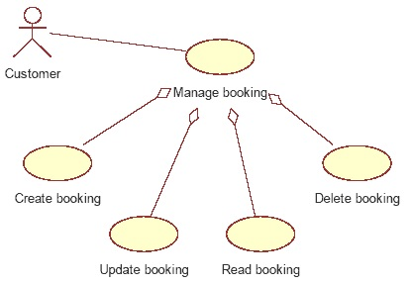
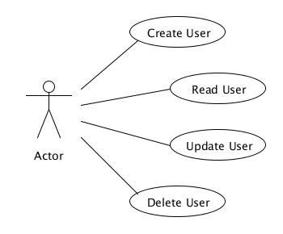
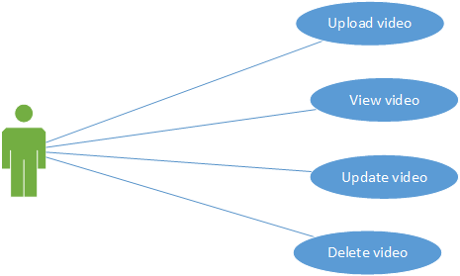
CRUD Examples
Notes:
https://stackoverflow.com/questions/7772399/crud-in-a-use-case-diagram
https://softwareengineering.stackexchange.com/questions/323040/should-written-use-cases-be-consistent-with-use-case-diagram

Slide 5
Topic List
What is CRUD?
Recap of Shop V3.0
Shop V4.0 (Driver.java):
revised menu (making it CRUD compliant)
recap of case 1 (add a product)
recap of case 2 (list a product)
coding case 4 (delete a product)
coding case 3 (update a product)

Slide 6
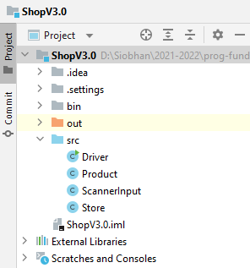
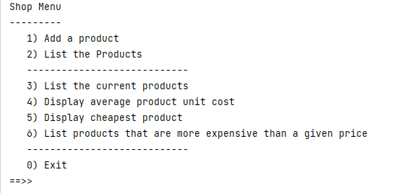
Shop V3.0
v3
Uses an ArrayList of Products to store the details.

Slide 7
RECAP: Shop V3.0
Driver
v3
Store
Product
Product class
Four instance fields
product’s name, code, unit cost, is in the current product line or not.
Basic class with Constructors, Getters, Setters and toString methods

Slide 8
RECAP: Shop V3.0
Driver
v3
Store
Product
Store class
One instance field, products (an ArrayList of Product).
Many additional methods
listProducts(), cheapestProduct(), listCurrentProducts(), etc.

Slide 9
RECAP: Shop V3.0
Driver
v3
Store
Product
Driver
Contains the main() method
Runs the menu
Negotiates with the user (i.e. handles I/O using the ScannerInput class)

Slide 10
RECAP: Shop V3.0
Add Product: Menu Option 1.
Read a Product(s): Menu Options 2 - 6.
The menu has NO Update or Delete!

Slide 11
Topic List
What is CRUD?
Recap of Shop V3.0
Shop V4.0 (Driver.java):
revised menu (making it CRUD compliant)
recap of case 1 (add a product)
recap of case 2 (list a product)
coding case 4 (delete a product)
coding case 3 (update a product)

Slide 12
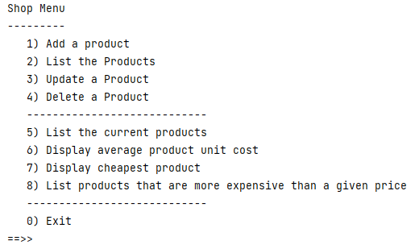
Shop V4.0 – Revised Menu
Option 1 – Create a Product
Option 2 – Read products
Option 3 – Update a product
Option 4 – Delete a product

Slide 13
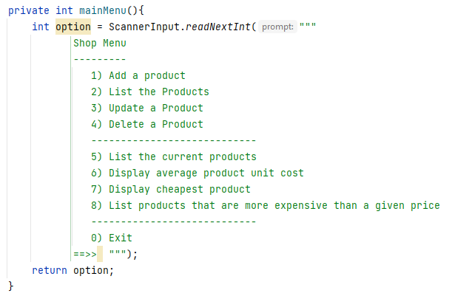
Shop V4.0 – Revised Menu
Now we need to update the switch to:
add code for case 3 (update) and 4 (delete) to Driver.java
move the current options for 3-6 to be 5-8.

Slide 14
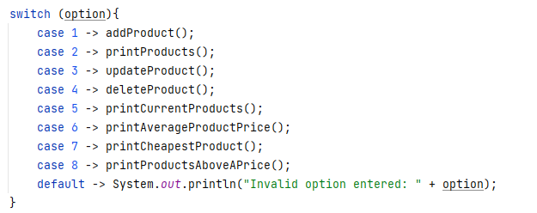
Shop V4.0 – Revised Menu
In Driver.java, we have provided a case 3 and 4, but we still need to write the actual methods:
updateProduct
deleteProduct
We have moved the options for
3-6 to 5-8.

Slide 15
Topic List
What is CRUD?
Recap of Shop V3.0
Shop V4.0 (Driver.java):
revised menu (making it CRUD compliant)
recap of case 1 (add a product)
recap of case 2 (list a product)
coding case 4 (delete a product)
coding case 3 (update a product)

Slide 16
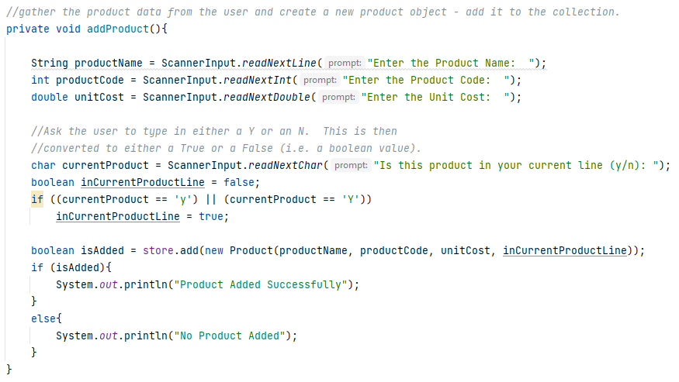
Driver.java code

Slide 17
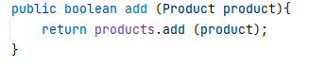
Driver.java code
Store.java code

Slide 18
Topic List
What is CRUD?
Recap of Shop V3.0
Shop V4.0 (Driver.java):
revised menu (making it CRUD compliant)
recap of case 1 (add a product)
recap of case 2 (list a product)
coding case 4 (delete a product)
coding case 3 (update a product)

Slide 19
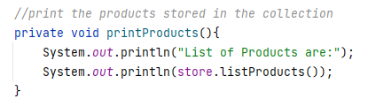
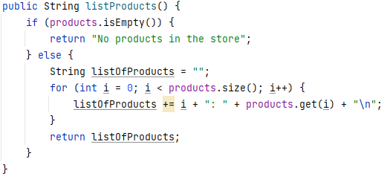
Driver.java code
Store.java code

Slide 20
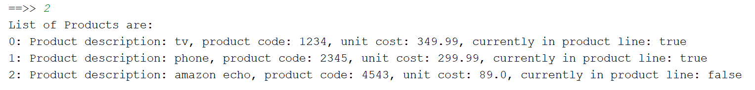
Driver.java code
Store.java code
Sample Output:

Slide 21
Topic List
What is CRUD?
Recap of Shop V3.0
Shop V4.0 (Driver.java):
revised menu (making it CRUD compliant)
recap of case 1 (add a product)
recap of case 2 (list a product)
coding case 4 (delete a product)
coding case 3 (update a product)

Slide 22
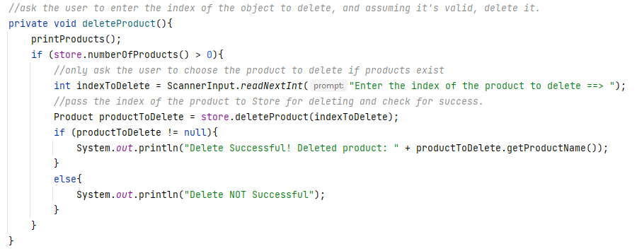
Driver.java code

Slide 23
Driver.java code
Validation: Checks products are in the ArrayList before asking the user for an index number.

Slide 24
Driver.java code
Validation: Checks It checks whether the delete was successful or not.

Slide 25
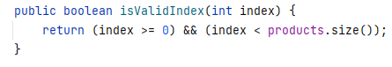
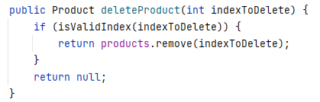
Store.java code
The isValidIndex method checks to see if the index (passed as a parameter) is valid i.e. it is greater than zero and less than the size of the products ArrayList.
Store.java code
If indexToDelete is a valid index in the products ArrayList, this method removes the product at that location from the ArrayList. The removed product is returned to Driver so it can be printed to the user.
Null is returned if indexToDelete is invalid.

Slide 26
Topic List
What is CRUD?
Recap of Shop V3.0
Shop V4.0 (Driver.java):
revised menu (making it CRUD compliant)
recap of case 1 (add a product)
recap of case 2 (list a product)
coding case 4 (delete a product)
coding case 3 (update a product)

Slide 27
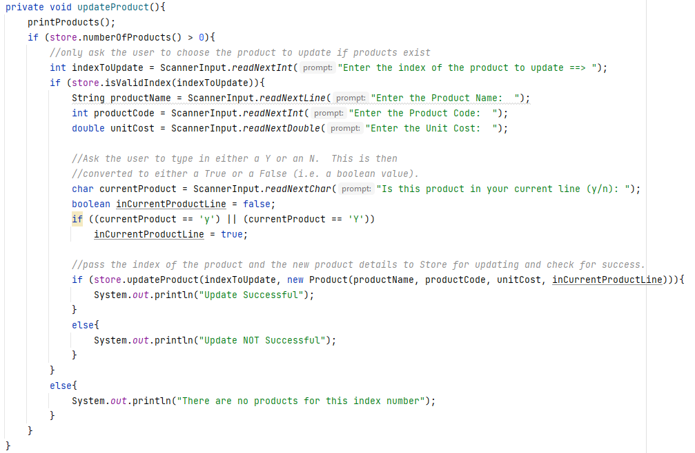
Driver.java

Slide 28
Driver.java
Validation: Makes sure products exist before asking user for any update details.

Slide 29
Driver.java
Validation: Makes sure the index number entered by the user is an index in the products ArrayList…

Slide 30
Driver.java
Validation: If the update failed, the user is informed of it, otherwise they get a successful message.

Slide 31
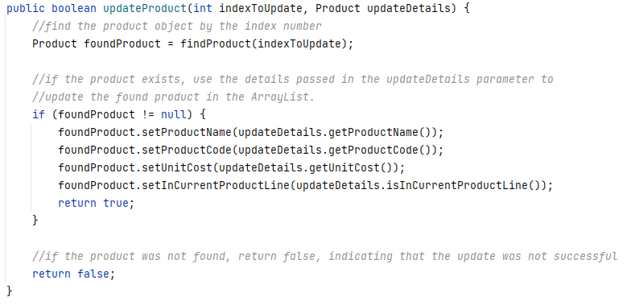
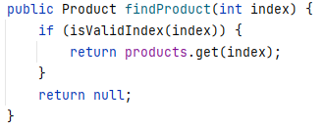
Store.java
Store.java

Slide 32

Any Questions?

